Slide 1
Biodiversity Capstone Project
Mary Eaton
16 March 2018

Slide 2
Objectives – PART I
Part I: Biodiversity in National Parks – Investigating Protected Species
Using species data collected by the National Parks Service, analyze conservation statuses across species categories
Investigate if there are any patterns or themes to the types of species that become endangered
Recommend focus for conservationists concerned about endangered species

Slide 3
Objectives – PARTs II & III
Part II: Discovering locations and count of specific species
Using a week of observation data, establish location and count of sheep in National Parks
Provide bar chart of results
Part III: Assisting program evaluation of foot and mouth disease reduction in National Parks
Assist Program evaluation – is reduction effort working
Determine sample size of sheep observations and time needed to investigate efficacy of foot and mouth treatment

Slide 4
part I: Biodiversity in National Parks – investigating protected species
Inspect dataframe
Analyze species conservation status
Count species in each conservation status (add no intervention status)
Bar chart
Are certain types of species more likely to be endangered?
By category: protected vs not protected counts
% of species in category that are protected
Significant differences in protected vs not by category?
Chi-squared on two; then another two
Contingency table

Slide 5
part I: Biodiversity in National Parks – Data Collected
NPS provided file species_info.csv, which provided category and conservation status data on 5541 species tracked in the National Parks.
The following information was in the file for each species:
(1) Category of species (category), which is one of the following:
Mammal
Bird
Reptile
Amphibian
Fish
Vascular Plant
Nonvascular Plant

Slide 6
part I: Biodiversity in National Parks – Data Collected II
(2) Scientific name of species (scientific_name), which is a unique name
(3) Common names of species (common_names), with multiple common names possible
(4) Conservation status (conservation_status), which is one of following:
No Intervention (listed as null or NaN on input file)
Species of Concern - declining population or appears to be in need of conservation
Endangered - seriously at risk of extinction
Threatened - vulnerable to endangerment in the near future
In Recovery - formerly Endangered, but currently not in danger of extinction throughout all or a significant portion of its inhabitable range
Example of some rows of data in this file are on the next slide.

Slide 7
part I: Biodiversity in National Parks – Example of data from species_info.csv
category scientific_name | common_names conservation_status
0 Mammal Clethrionomys gapperi gapperi | Gapper's Red-Backed Vole NaN
1 Mammal Bos bison | American Bison, Bison NaN
2 Mammal Bos taurus | Aurochs, Aurochs, Domestic Cattle (Feral), Dom... NaN
3 Mammal Ovis aries | Domestic Sheep, Mouflon, Red Sheep, Sheep (Feral) NaN
4 Mammal Cervus elaphus | Wapiti Or Elk NaN

Slide 8
part I: Biodiversity in National Parks – Data Inventory
How many of each species fall into the designated categories?
The distribution of tracked species by category is:
The majority of species tracked are plants, especially vascular plants.
Category | Count of Species
Amphibian | 79
Bird | 488
Fish | 125
Mammal | 176
Nonvascular Plant | 333
Reptile | 78
Vascular Plant | 4262
 | 5541

Slide 9
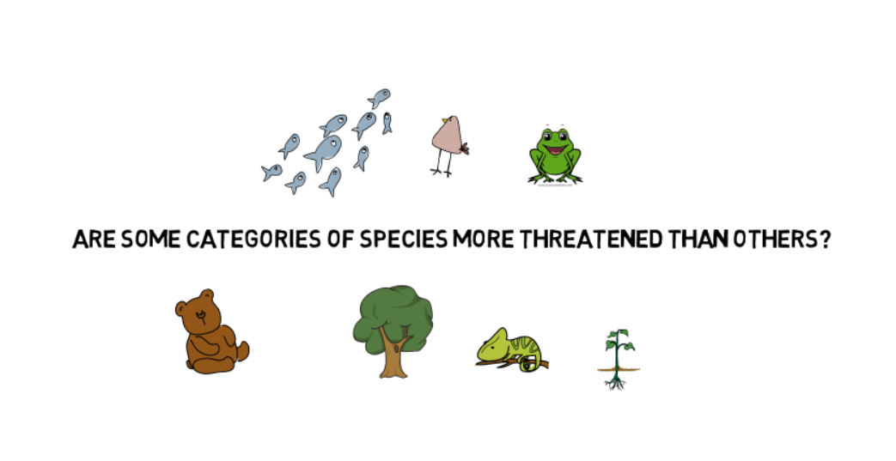
part I: Biodiversity in National Parks – research question

Slide 10
part I: Biodiversity in National Parks – Count of conservation status by species
How many of each species fall into these conservation statuses?
The 5541 species have the following distribution of conservation statuses:
This information is presented graphically on the next slide.
All null values in conservation status were assigned “No Intervention.”
NOTE: The asterisks represent adjustments due to duplicate conservation statuses on same species. See explanation on slide after graph.
conservation_status | Count
Endangered | 15
In Recovery | 4 | * (-1)
No Intervention | 5363 | * (-1)
Species of Concern | 151
Threatened | 10
Total | 5543 | 5541

Slide 11
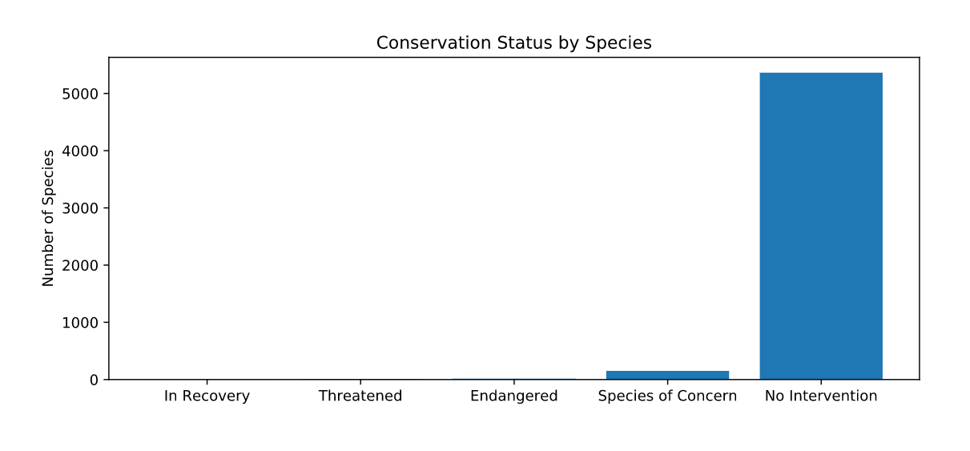
part I: Biodiversity in National Parks – Distribution of Conservation Statuses by Number of Species

Slide 12
part I: Biodiversity in National Parks – *Explanation of count discrepancies
There are 5541 species, yet the total on the initial distribution yields a count of 5543.
Two species had multiple conservation status values:
Species Canus lupi (gray wolf) was listed three times: twice as being “Endangered,” and once as “In Recovery.” The “In Recovery” count was removed for that species in this chart (not in dataset).
Similarly, the species Oncorhynchus mykiss (rainbow trout) was listed twice, once as “Threatened” and once as null. The “Threatened” status was preserved, and the null (“No Intervention”) was removed from the count in the chart (data set was not modified).
conservation_status | count | adjusted count
Endangered | 15 | 15
In Recovery | 4 | * (-1) 3
No Intervention | 5363 | * (-1) 5362
Species of Concern | 151 | 151
Threatened | 10 | 10
 | 5543 | 5541

Slide 13
part I: Biodiversity in National Parks – Are certain types of species more likely to be endangered?
To answer this question, combined all variations of protection status into one status of “Protected,” and those with status of “No Intervention” were considered “Not Protected.”
For each category, calculated the count and percentage of protected versus not protected species:
The highest percentage of species in protected status are in the categories of Mammals (17.0%) and Birds (15.4%).
Are Mammals more likely to be endangered than Birds? Performed a chi-squared test, which indicated the difference between these two categories is not significant (p-value of 0.6876).
Are Mammals more likely to be endangered than Reptiles? A separate chi-squared test between Mammals and Reptiles indicates that Mammals are significantly more likely to have a protected status than Reptiles (p-value of 0.0384).
category | not_protected | protected | percent_protected
Amphibian | 72 | 7 | 8.860759
Bird | 413 | 75 | 15.368852
Fish | 115 | 11 | 8.730159
Mammal | 146 | 30 | 17.045455
Nonvascular Plant | 328 | 5 | 1.501502
Reptile | 73 | 5 | 6.410256
Vascular Plant | 4216 | 46 | 1.079305

Slide 14
part I: Biodiversity in National Parks – Recommendation for conservationists
Mammals and birds are the categories with more species in protected status
Given limited resources, more consideration should be given to conservation efforts to species in these two categories
Conservationists could also consider whether there is any bias in initial assignment of conservation status, which may favor animals over plants, and favor more familiar (or more similar to human) animal categories over the lesser known or less similar

Slide 15
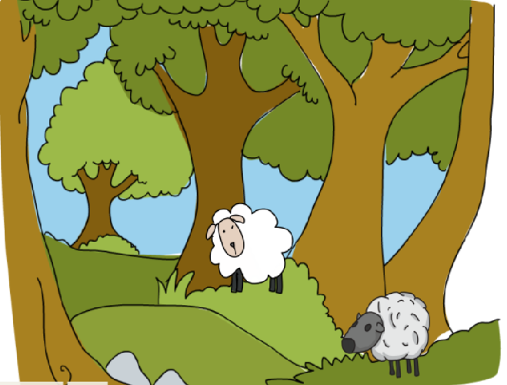
Part II: Discovering locations and count of specific species – Sheep observations

Slide 16
Part II: Discovering locations and count of specific species
Observations dataframe – overview
Goal: track sheep locations
Observations has locations, but not know which are sheep;
only have scientific names
Need info from species dataframe –
to get sheep common name to narrow down
How found sheep rows in species
How merge to observations dataframe to get combined
information needed
- Bar chart of counts of sheep by park

Slide 17
Observations of species from several National Parks
Overall info
New observations file – observations for last 7 days from multiple national parks
The National Parks Service sent over another dataset for you to analyze.
Conservationists have been recording sightings of different species at several national parks for the past 7 days. Their observations have been sent to you in a file called observations.csv.
[describe file]
A team of ruminant-enthused scientists has been tracking the movements of various species of sheep across different national parks and have asked for your assistance in analyzing the observation and species DataFrames to help track sheep locations.
Sheep of interest – not a category (subset of mammal), so create a sheep indicator based on common name containing the word sheep and being a mammal (exclude plants like common sheep sorrel)

Slide 18
You've determined what species in species df are sheep, but now you need to determine where these sheep are locating by combining the data in sheep_species and observations.
total number of sheep observed in each park over the past 7 days
Now it's time to graph the sheep observation data. If we want the figure to easily show the number of sightings at each of the four national parks under investigation, a bar chart is probably the best bet.
Create a bar chart showing the different number of observations per week at each park.

Slide 19
Observations data frame contains:
Scientific name (scientific_name), unique to species
National Park in which observation occurred (park_name)
Parks are Great Smoky Mountains National Park, Yosemite National Park,
Bryce National Park, Yellowstone National Park
Number of observations in 7 day period (observations)
Sample of data in observations

Slide 20
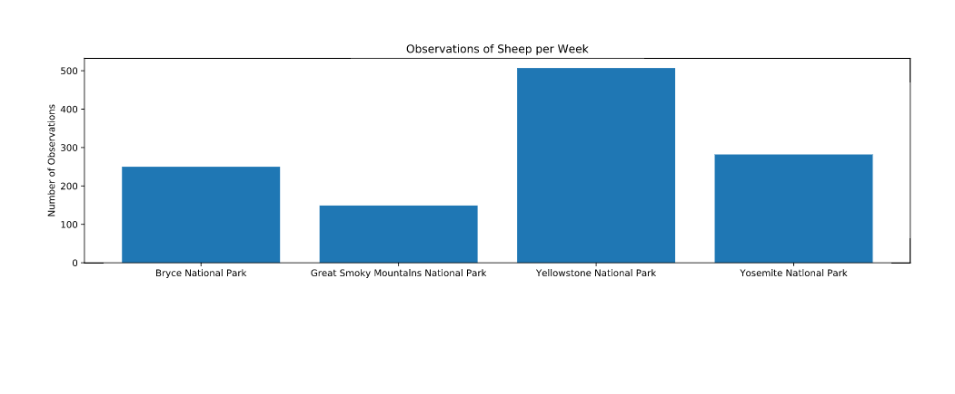

Slide 21
Park Rangers at Yellowstone National Park have been running a program to reduce the rate of foot and mouth disease at that park. The scientists want to test whether or not this program is working. They want to be able to detect reductions of at least 5 percentage point. For instance, if 10% of sheep in Yellowstone have foot and mouth disease, they'd like to be able to know this, with confidence.
The only information that the scientists currently have is that last year it was recorded that 15% of sheep at Bryce National Park have foot and mouth disease. Using this value and the sample size calculator in the browser window on the right, you will need to calculate the number of sheep that they would need to observe from each park to make sure their foot and mouth percentages are significant. Use the default level of significance (90%).
For reference, here is obs_by_park table from the previous exercise:
 | park_name | observations
0 | Bryce National Park | 250
1 | Great Smoky Mountains National Park | 149
2 | Yellowstone National Park | 507
3 | Yosemite National Park | 282

Slide 22
Foot and mouth reduction effort –
Program evaluation – is reduction effort working?
Will count as effective if at least 5% reduction in disease
Yellowstone NP is target area
Sample size determination
Get baseline available from Bryce Canyon NP
Calculate number of sheep to observe
Number of weeks to get this number per park, based on 7 day counts

Slide 23
baseline = 15.0
minimum_detectable_effect = 100 * 5.0/ baseline
print minimum_detectable_effect
sample_size_per_variant = 510
yellowstone_weeks_observing = sample_size_per_variant / 507.0
print yellowstone_weeks_observing
bryce_weeks_observing = sample_size_per_variant / 250.0
print bryce_weeks_observing

Slide 24
Foot and Mouth Reduction Effort
33.3333333333
1.00591715976
2.04
Note: had to use optimizely sample size calculator to get this number, not the one on the codecademy site
https://www.optimizely.com/sample-size-calculator/?conversion=15&effect=33.333&significance=90

Slide 25
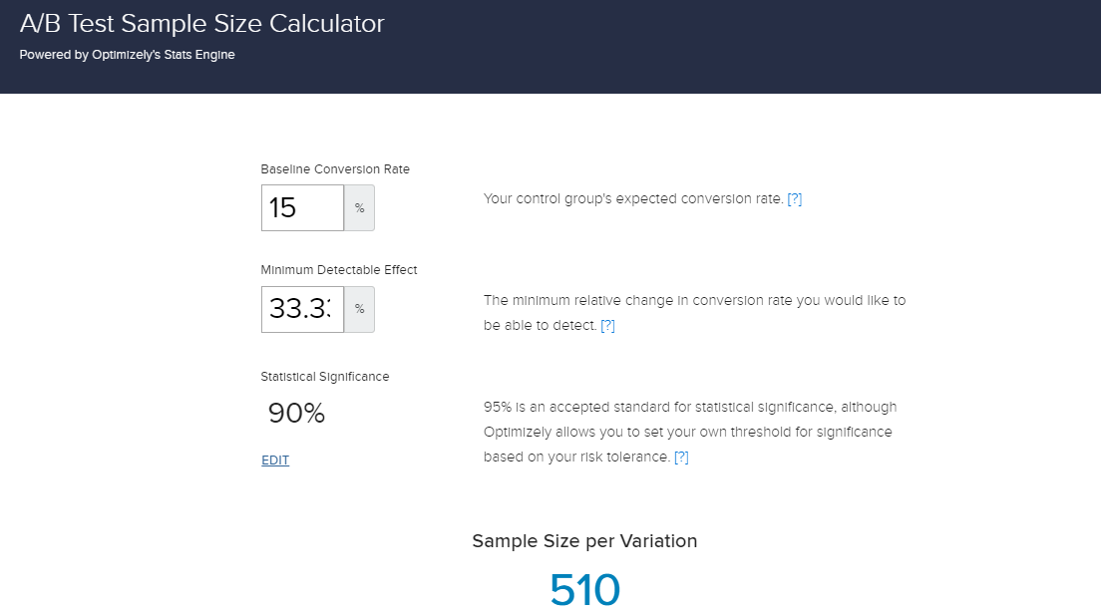
Foot and mouth

Slide 26
What do the results of the last exercise tell us?
Given a baseline of 15% occurrence of foot and mouth disease in sheep at Bryce National Park, you found that if the scientists wanted to be sure that a >5% drop in observed cases of foot and mouth disease in the sheep at Yellowstone was significant they would have to observe at least 510 sheep.
Then, using the observation data you analyzed earlier, you found that this would take approximately one week of observing in Yellowstone to see that many sheep, or approximately two weeks in Bryce to see that many sheep.
Congratulations! You've completed Part 2 of the Biodiversity at National Parks Data Analysis Project!
Consider this, starting from only two DataFrames containing species information and species sightings, you were able to create several informative visualizations, perform chi-squared tests to answer the question: "Are some species more likely to be endangered than others?", determine the best place to observe sheep, and calculate the sample size necessary for confident measurements in a disease reduction study.

